Slide 1
Configuring IPSEC

Slide 2
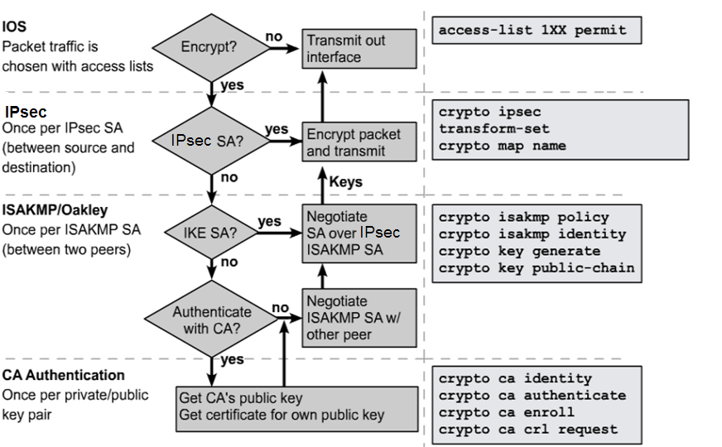
IKE and IPsec Flowchart
3
2
1

Slide 3
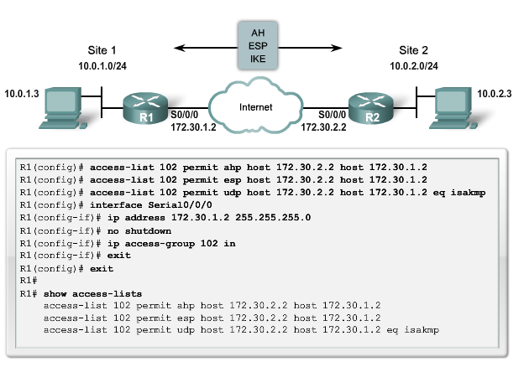
Task 1: Configure ACLs to Allow Traffic
ESP = protocol # 50, AH = protocol # 51, ISAKMP = UDP port 500
Allow the above to traverse the link over the internet.

Slide 4
Task 2: Configure IKE
Creating a plan in advance is mandatory to configure IPsec encryption correctly to minimize misconfiguration.
Determine the following policy details:
  Key distribution method
  Authentication method
  IPsec peer IP addresses and hostnames
  IKE phase 1 policies for all peers
  Encryption algorithm, Hash algorithm, IKE SA lifetime
Goal: Minimize misconfiguration.

Slide 5
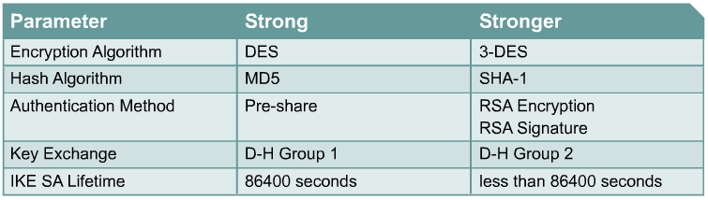
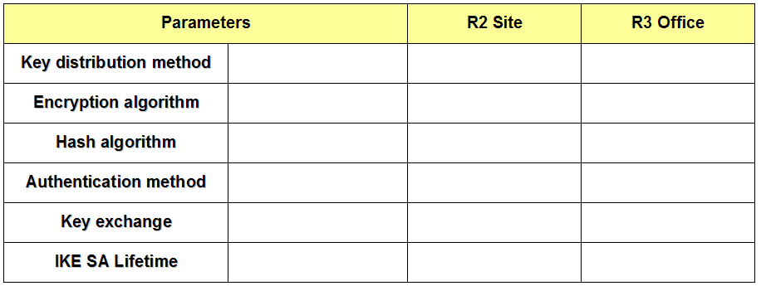

IKE Phase 1 Policy Parameters
or AES
or D-H 5

Slide 6
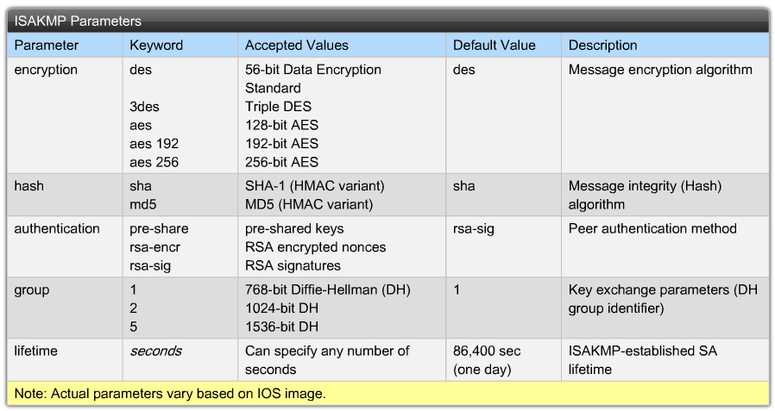
Default ISAKMP Settings

Slide 7
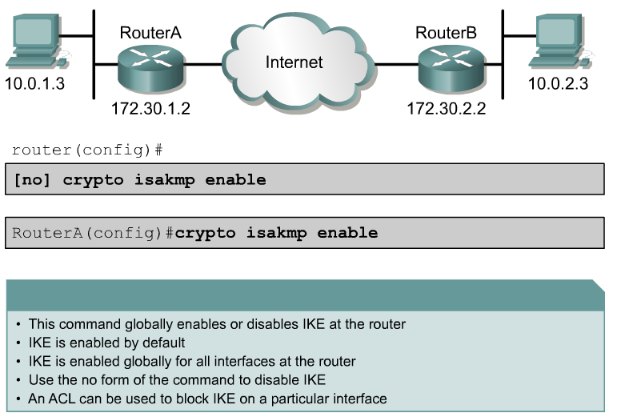
Enable IKE

Slide 8
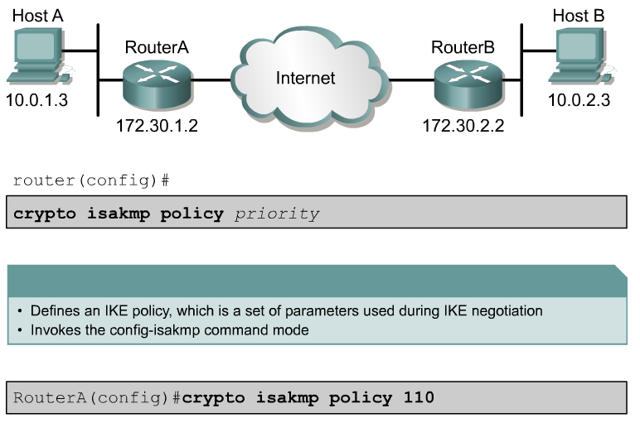
Create an IKE Policy

Slide 9
Sample ISAKMP Settings
RouterA# show crypto isakmp policy
Protection suite of priority 110
encryption algorithm: DES - Data Encryption Standard (56 bit keys).
hash algorithm: Message Digest 5
authentication method: Pre-Shared Key
Diffie-Hellman group: #1 (768 bit)
lifetime: 86400 seconds, no volume limit
Default protection suite
encryption algorithm: DES - Data Encryption Standard (56 bit keys).
hash algorithm: Secure Hash Standard
authentication method: Rivest-Shamir-Adleman Signature
Diffie-Hellman group: #1 (768 bit)
lifetime: 86400 seconds, no volume limit

Slide 10
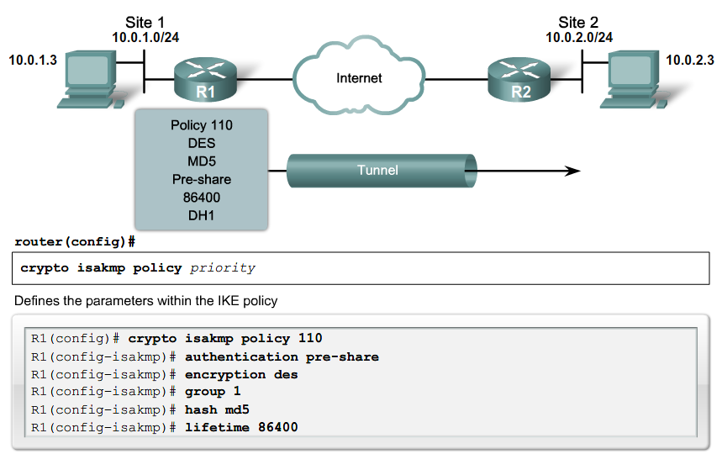
Create an IKE Policy

Slide 11
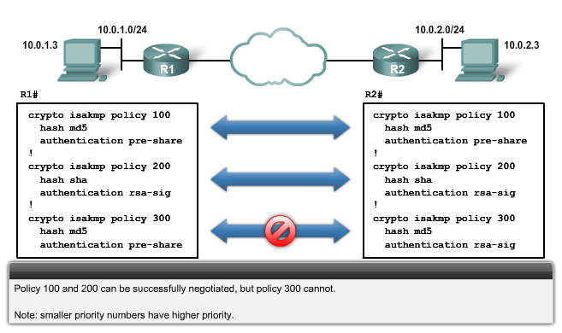
ISAKMP Policy Negotiation

Slide 12
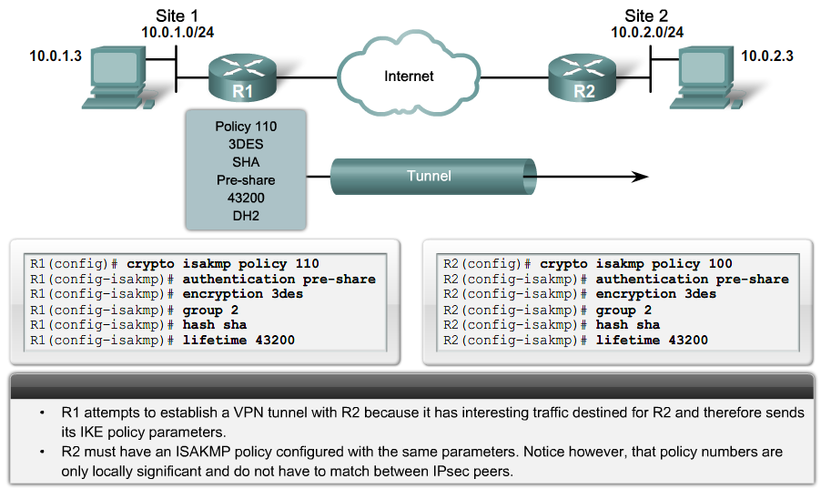
ISAKMP Policy Negotiation

Slide 13
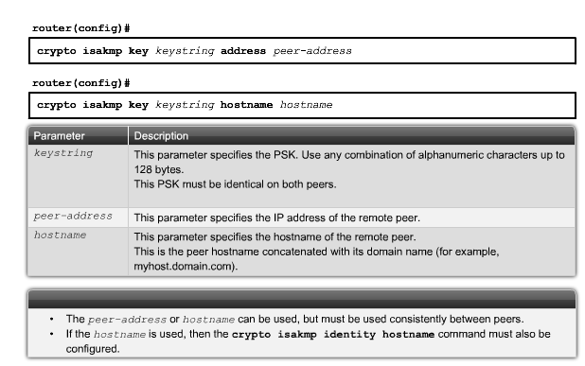
Configure Pre-Shared Keys
By default, the ISAKMP identity is set to use the IP address.

Slide 14
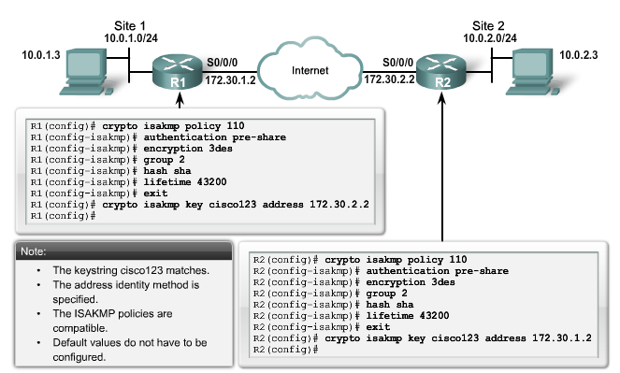
Configure Pre-Shared Keys

Slide 15
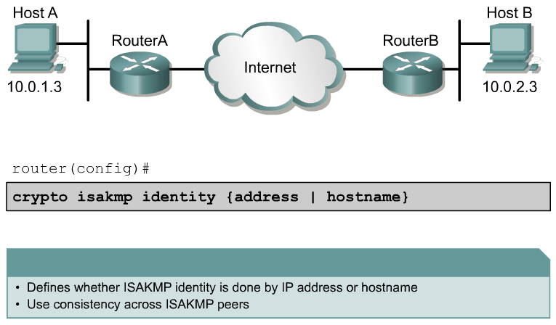
Configure ISAKMP Identity
To use the hostname parameter, configure the crypto isakmp identity hostname global configuration mode command.
  In addition, DNS must be accessible to resolve the hostname.

Slide 16
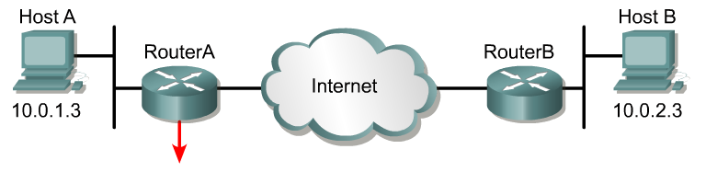
Verify IKE Configuration
RouterA# show crypto isakmp policy
Protection suite of priority 110
encryption algorithm: DES - Data Encryption Standard (56 bit keys).
hash algorithm: Message Digest 5
authentication method: Pre-Shared Key
Diffie-Hellman group: #1 (768 bit)
lifetime: 86400 seconds, no volume limit
Default protection suite
encryption algorithm: DES - Data Encryption Standard (56 bit keys).
hash algorithm: Secure Hash Standard
authentication method: Rivest-Shamir-Adleman Signature
Diffie-Hellman group: #1 (768 bit)
lifetime: 86400 seconds, no volume limit

Slide 17
Task 3: Configure the Transform Sets
Determine the following policy details:
  IPsec algorithms and parameters for optimal security and performance
  Transforms sets
  IPsec peer details
  IP address and applications of hosts to be protected
  Manual or IKE-initiated SAs
Goal: Minimize misconfiguration.

Slide 18
IPsec Transforms Supported in IOS
Cisco IOS software supports the following IPsec transforms:
CentralA(config)# crypto ipsec transform-set transform-set-name ?
ah-md5-hmac AH-HMAC-MD5 transform
ah-sha-hmac AH-HMAC-SHA transform
esp-3des ESP transform using 3DES(EDE) cipher (168 bits)
esp-des ESP transform using DES cipher (56 bits)
esp-md5-hmac ESP transform using HMAC-MD5 auth
esp-sha-hmac ESP transform using HMAC-SHA auth
esp-null ESP transform w/o cipher
Note:
  esp-md5-hmac and esp-sha-hmac provide more data integrity.
  They are compatible with NAT/PAT and are used more frequently than ah-md5-hmac and ah-sha-hmac.

Slide 19
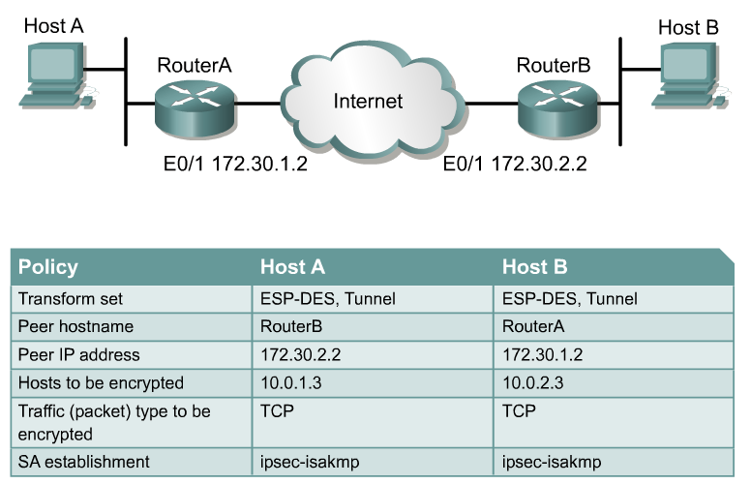
IPsec Policy Example

Slide 20
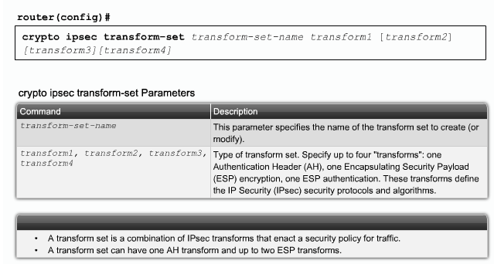
Configure Transform Sets

Slide 21
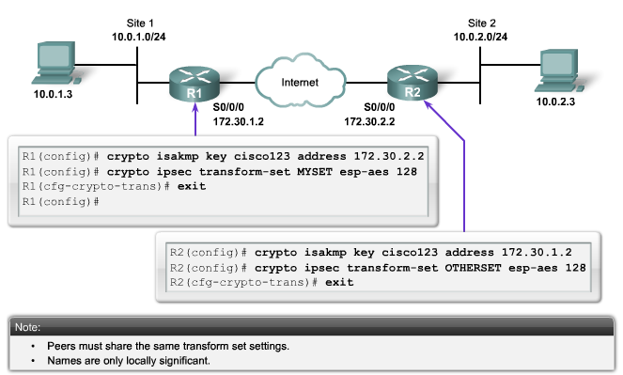
Transform Set Negotiation

Slide 22
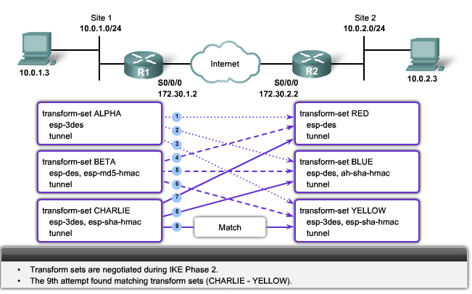
Transform Set Negotiation

Slide 23
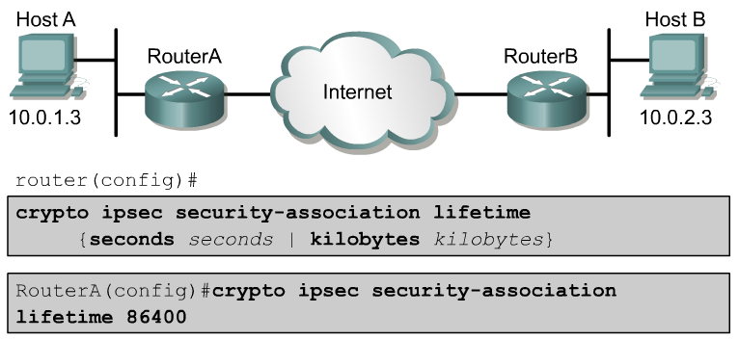
Configure Security Association Lifetimes
Configures global IPsec lifetime values used when negotiating IPsec security associations.
IPsec SA lifetimes are negotiated during IKE phase 2.

Slide 24
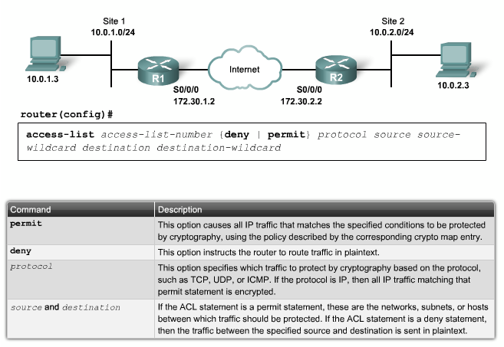
Task 4: Configure Crypto ACLs
tcp

Slide 25
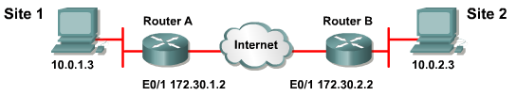
Configure Symmetrical Peer Crypto ACL
RouterA#(config)
access-list 110 permit tcp 10.0.1.0 0.0.0.255 10.0.2.0 0.0.0.255
RouterB#(config)
access-list 110 permit tcp 10.0.2.0 0.0.0.255 10.0.1.0 0.0.0.255

Slide 26
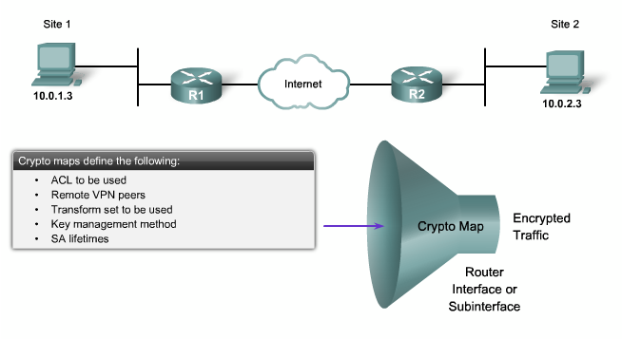
Task 5: Apply the Crypto Map

Slide 27
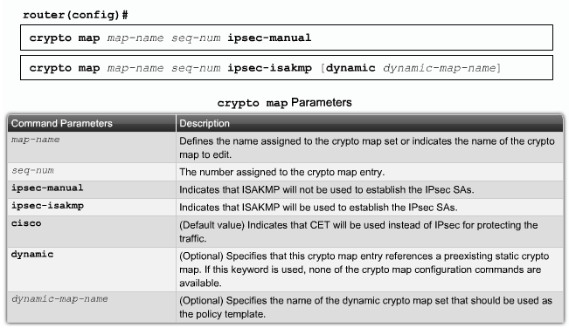
Configure IPsec Crypto Maps

Slide 28
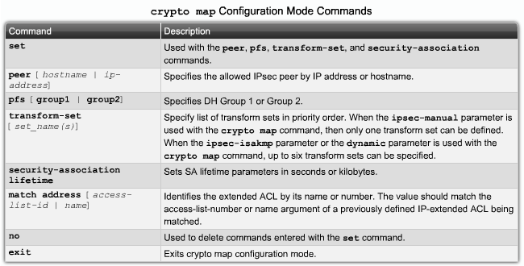
Configure IPsec Crypto Maps

Slide 29
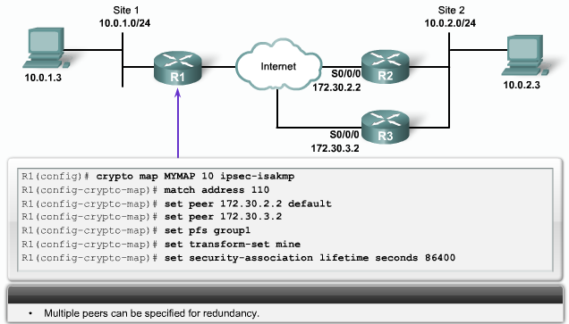
Configure IPsec Crypto Maps

Slide 30
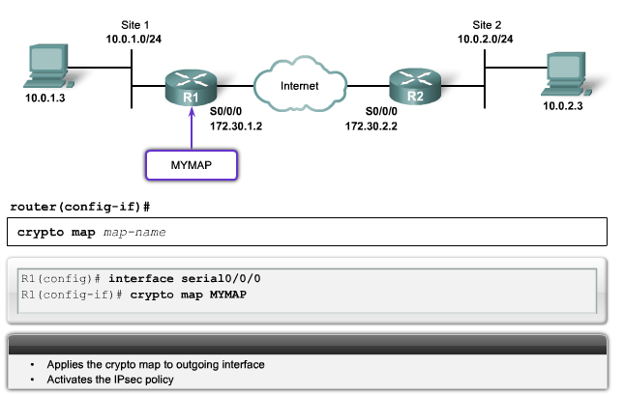
Applying Crypto Maps to Interfaces

Slide 31
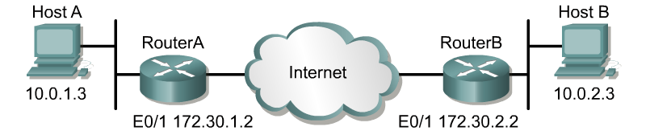
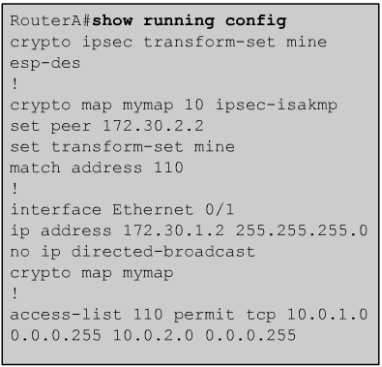
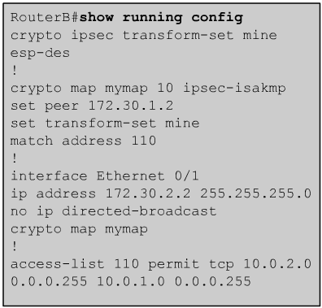
IPsec Configuration Examples

Slide 32
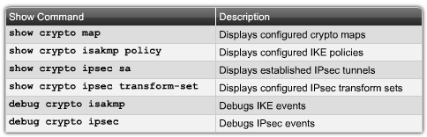
Verify IPsec

Slide 33
clear commands
Clears IPsec Security Associations in the router database.
Router#
clear crypto sa
clear crypto sa peer <IP address | peer name>
clear crypto sa map <map name>
clear crypto sa entry <destination-address protocol spi>

Slide 34
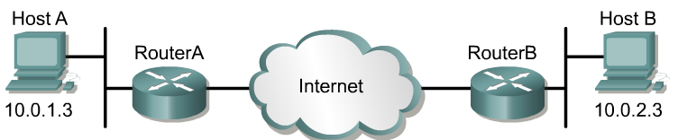
View Policy
RouterA# show crypto isakmp policy
Protection suite of priority 110
encryption algorithm: DES - Data Encryption Standard (56 bit keys).
hash algorithm: Message Digest 5
authentication method: pre-share
Diffie-Hellman group: #1 (768 bit)
lifetime: 86400 seconds, no volume limit
Default protection suite
encryption algorithm: DES - Data Encryption Standard (56 bit keys).
hash algorithm: Secure Hash Standard
authentication method: Rivest-Shamir-Adleman Signature
Diffie-Hellman group: #1 (768 bit)
lifetime: 86400 seconds, no volume limit

Slide 35
View Defined Sets
A
E0/1 172.30.1.2
E0/1 172.30.2.2
RouterA# show crypto ipsec transform-set MY-SET
Transform set MY-SET: { esp-des }
will negotiate = { Tunnel, },

Slide 36
Display Phase 1 SA
QM_IDLE (quiescent state) indicates that an ISAKMP SA exists but is idle.
The router will remain authenticated with its peer and may be used for subsequent quick mode (QM) exchanges.
A
E0/1 172.30.1.2
E0/1 172.30.2.2
RouterA# show crypto isakmp sa
dst src state conn-id slot
172.30.2.2 172.30.1.2 QM_IDLE 47 5

Slide 37
View Crypto IPsec SA
A
E0/1 172.30.1.2
E0/1 172.30.2.2
RouterA# show crypto ipsec sa
interface: Ethernet0/1
  Crypto map tag: MYMAP, local addr. 172.30.1.2
  local ident (addr/mask/prot/port): (172.30.1.2/255.255.255.255/0/0)
  remote ident (addr/mask/prot/port): (172.30.2.2/255.255.255.255/0/0)
  current_peer: 172.30.2.2
  PERMIT, flags={origin_is_acl,}
  #pkts encaps: 21, #pkts encrypt: 21, #pkts digest 0
  #pkts decaps: 21, #pkts decrypt: 21, #pkts verify 0
  #send errors 0, #recv errors 0
  local crypto endpt.: 172.30.1.2, remote crypto endpt.: 172.30.2.2
  path mtu 1500, media mtu 1500
  current outbound spi: 8AE1C9C

Slide 38
View Configured Crypto Maps
A
E0/1 172.30.1.2
E0/1 172.30.2.2
RouterA# show crypto map
Crypto Map “MYMAP" 10 ipsec-isakmp
  Peer = 172.30.2.2
  Extended IP access list 102
  access-list 102 permit ip host 172.30.1.2 host 172.30.2.2
  Current peer: 172.30.2.2
  Security association lifetime: 4608000 kilobytes/3600 seconds
  PFS (Y/N): N
  Transform sets={ MINE, }

Slide 39
The End

